Slide 1


CMR TECHNiCAL CAMPUS UGC AUTONOMOUS Accredited by NBA & NAAC with A Grade Approved by AICTE, New Delhi and Affiliated to JNTU, Hyderabad
DEPARTMENT OF COMPUTER SCIENCE AND ENGINEERING
MINI PROJECT
ON
PREDICTING RATING FROM REVIEW ANALYSIS
GUIDED BY
B P DEEPAK KUMAR(Asst. Prof)
Presented by
Yogitha Sree Annangi (197R1A0559)
Chandana Yarlagadda (197R1A0557)
Deverakonda Veena Laxmi Gayatri (197R1A0511)

Slide 2
OverView
Abstract
Introduction
Existing System
Disadvantages
Proposed System
Advantages
Hardware and Software Requirements
Architecture
Modularity
UML Diagrams
Novelty
Conclusion

Slide 3
Abstract
We present a customer feedback reviews on product, where we utilize opinion mining, text mining and sentiments, which has affected the surrounded world by changing their opinion on a specific product.
Data used in this study are online product reviews collected from https://Amazon.com.We performed a comparative sentiment analysis of retrieved reviews.
Amazon data with collection of review text, product details, rating and review are taken as input.

Slide 4
Existing System
Conventionally, sentiment analysis has been about opinion contradiction, i.e, whether someone has positive, neutral, or negative opinion towards something.
Auto detection of text and giving rating for given product was not performed in existing system.

Slide 5
Disadvantages
Opinion mining, positive and negative analysis was only done.
Automatic prediction of rating from review with various analysis reports was not performed in existing system.

Slide 6
Proposed System
Machine learning techniques are used for processing, vectorizing, classifier and features are extracted from the dataset and prediction is performed for given review and accuracy of model is calculated.

Slide 7
Advantages
Various data analysis factors are covered for product analysis.
Automatic rating calculation is done using machine learning classifier.

Slide 8
Hardware requirements
Processor : intel core i3
Hard Disk : 500GB
RAM : 2GB

Slide 9
Software requirements
Operating system. : Windows7/10/11
Coding Language : Python
Development Environment : Anaconda
Dataset : Amazon review rating
IDE : Jupyternotebook

Slide 10
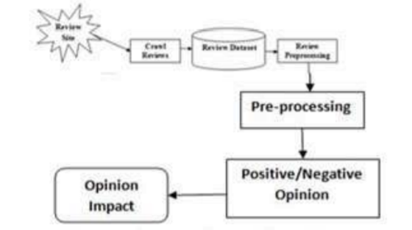
Architecture

Slide 11
Modularity
Dataset Collection :
In this module amazon dataset is collected from Kaggle website and features and labels are extracted from the dataset.
Preprocessing :
In this module data is divided to features and labels and converted to required format using vectorizer.
Data Analysis :
Data analysis is performed to show graphs on various factors of data.

Slide 12
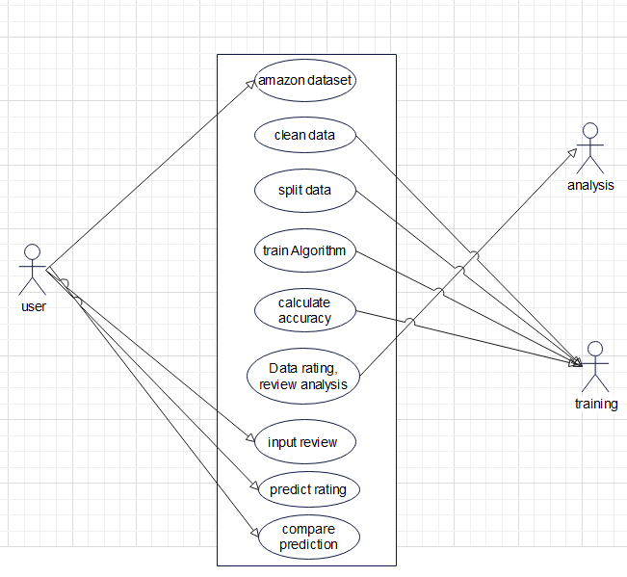
UML Diagrams
USE CASE DIAGRAM

Slide 13
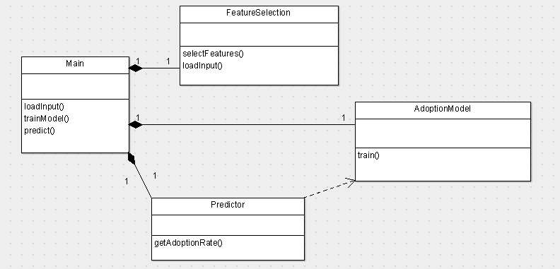
CLASS DIAGRAM

Slide 14
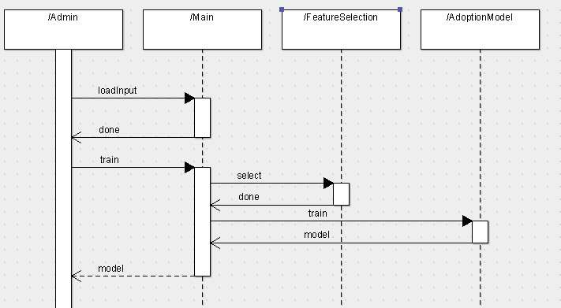
SEQUENCE DIAGRAM

Slide 15
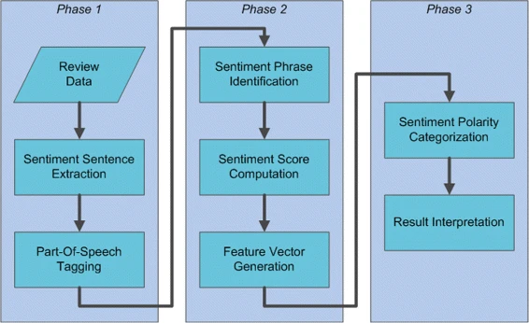
Activity diagram

Slide 16
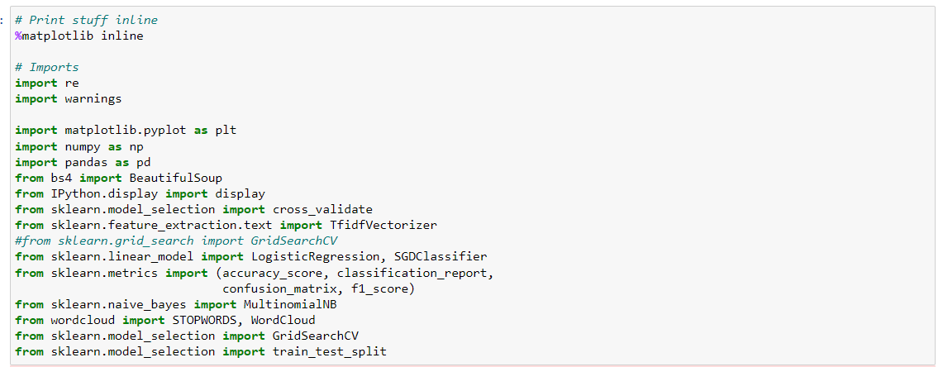
Sample Code

Slide 17
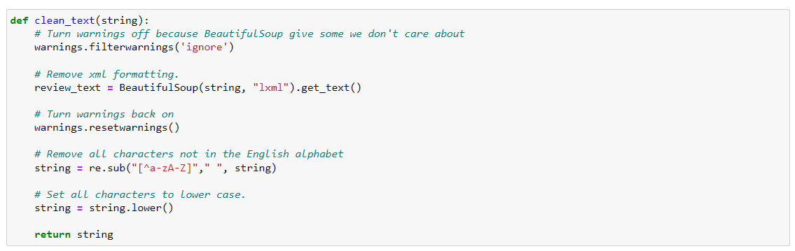

Slide 18
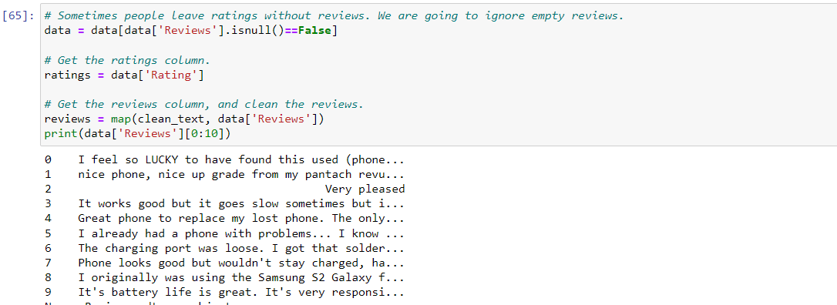
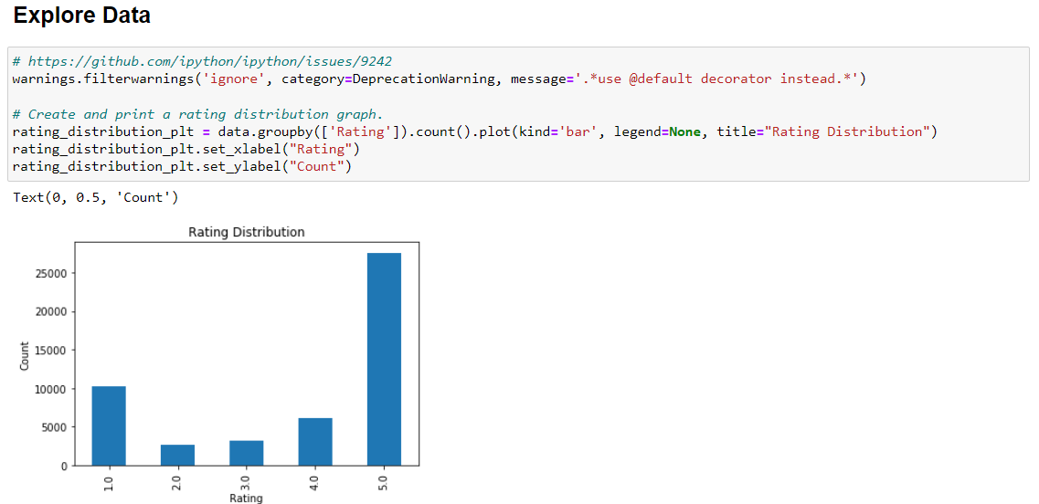
Results

Slide 19
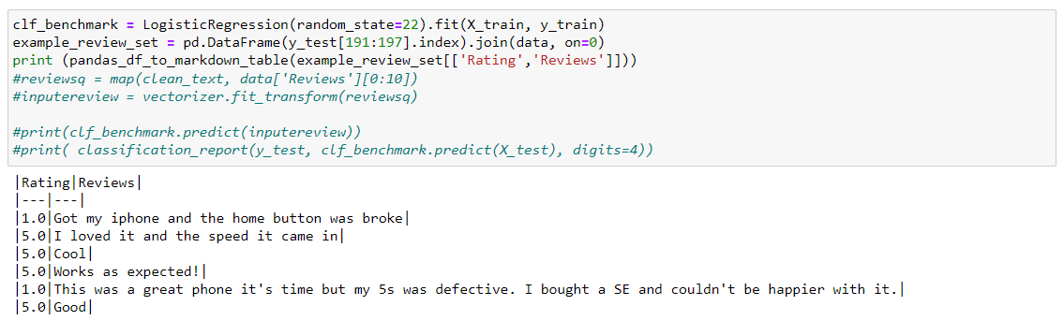

Slide 20
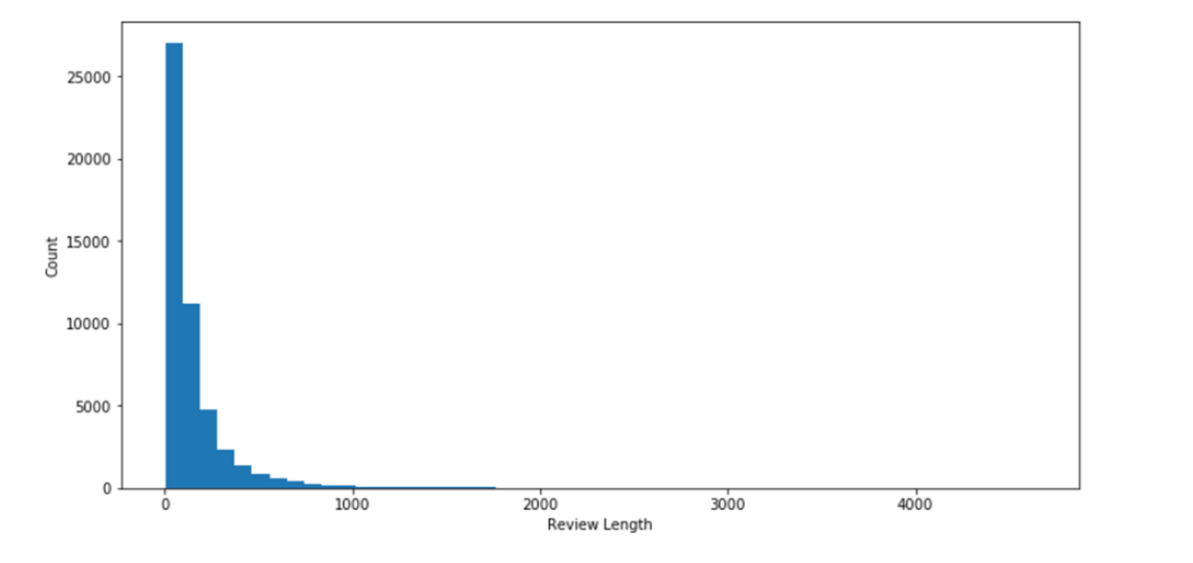

Slide 21
Future Enhancement
Here we propose a automatic text detection algorithm that analyses the text and classifies the words.
The proposed Algorithms has achieved accuracy of 0.85%.
There is no man work needed as the proposed algorithm classifies sentiments behind the text automatically.

Slide 22
Novelty
We use two different algorithms to predict the accuracy of the rating
The two different algorithms are:
Multinomial NB
SGD Classifier
The proposed Multinomial NB Algorithm has achieved accuracy of 0.79%.
The proposed SGD Classifier Algorithm has achieved accuracy of 0.85%.

Slide 23
Multinomial NB
This algorithm is a family of probabilistic algorithms based on applying Bayes’ theorem with the “naive” assumption of conditional independence between every pair of a feature.
SGD Classifier
Stochastic Gradient Descent (SGD) is a simple yet efficient optimization algorithm used to find the values of parameters/coefficients of functions that minimize a cost function.
Support Vector Classifier
Support Vector Classifier(SVC) is a supervised machine learning algorithm used for both classification and regression.

Slide 24
Conclusion
We use sentiment analysis as the research area for our project.
Linear Support Vector Classifier algorithm is used to classify the reviews into positive, negative or neutral.
Linear SVC has better performance practically in most cases, it is also computationally cheaper.
Predicting rating from review analysis gives the ability to customer on successfully deciding whether a rating will be helpful for purchasing product.
GitHub Link : https://github.com/ushashwat/Amazon-Rating-Prediction/blob/main/amazon_rating_prediction.ipynb

Slide 25
THANK YOU

